Slide 1

SAFEBEAT
Weekly Update
Aaradanaa Sabitha Mohan, Venkata Sai Kotrike, Brian York, Jonathan Zheng, Anthony Dinh

Slide 2





MEET THE TEAM
Venkata Sai Kotrike
Jonathan Zheng
Software Engineer
Hardware Engineer
Aaradanaa Sabitha Mohan
Project Manager
Anthony Dinh
Brian York
Mechanical Engineer
Test Engineer
Notes:
All

Slide 3
AGENDA
01
02
03
Project Description
Block Diagrams
Customer Requirements
Problem Statement and Solution
04
05
Project Status
Design Overview
Software, Electrical, Mechanical Updates
Labors Costs, Budget. & Gantt Chart
Notes:
Aara

Slide 4
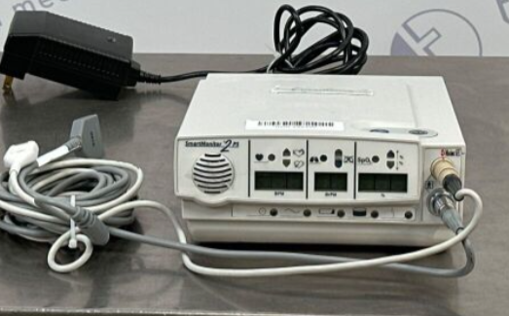
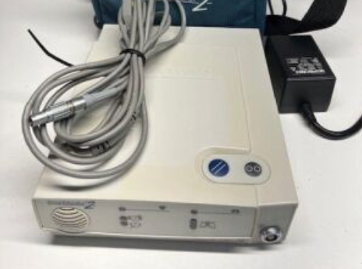
BACKGROUND
Sleep Apnea: A health condition where breathing temporarily stops during sleep.
SafeBeat: A next-gen Infant Apnea Monitor
Wireless, Bluetooth-enabled, and portable for modern connectivity and convenience.
Real-time monitoring of heart rate and respiratory rate with alarms for abnormal conditions.
User-friendly interface with display and button controls
Apnea Monitor by CIRCADIANCE
Apnea Monitor by RESPIRONICS
Notes:
Aara
Each year, more than 3000 families in the U.S are impacted by SIDs.
Current apnea monitors are outdated, wired, and present safety risks like choking hazards and restricted mobility.

Slide 5
CUSTOMER REQUIREMENTS
Apnea Monitor Belt:
Dimensions of belt to accommodate chest sizes from 15.5 in to 20 in (typical size from 0-7 lbs newborn to 2 year old)
Equipped with sensors for heart rate and respiratory rate monitoring.
Wireless transmission using Bluetooth.
Control Box:
Battery-powered, portable device
User interface (display and button controls).
Built-in customizable alarm system to notify abnormal biometrics.
Dimensions of the box will be no greater than 8 in x 6 in x 6 in
Datalogging
Notes:
Aara

Slide 6
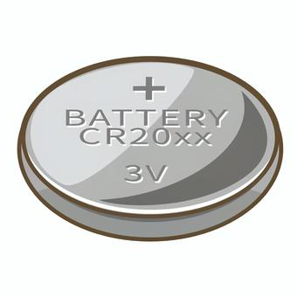
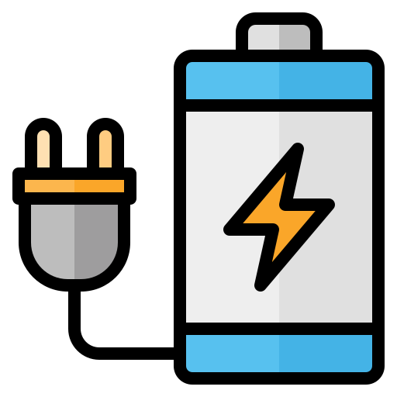
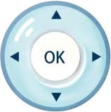

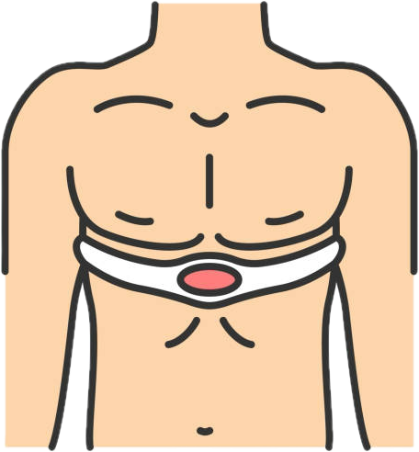




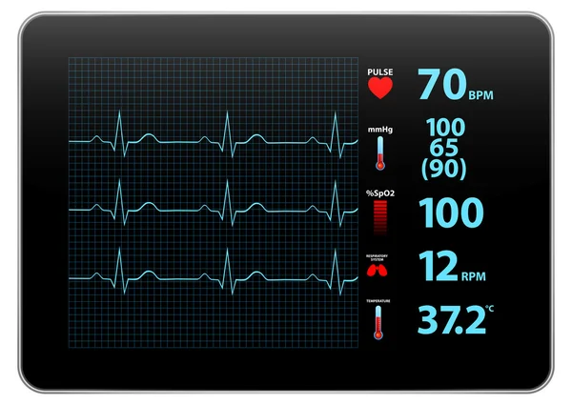
Belt Monitor
Control Box
Notes:
Charan

Slide 7
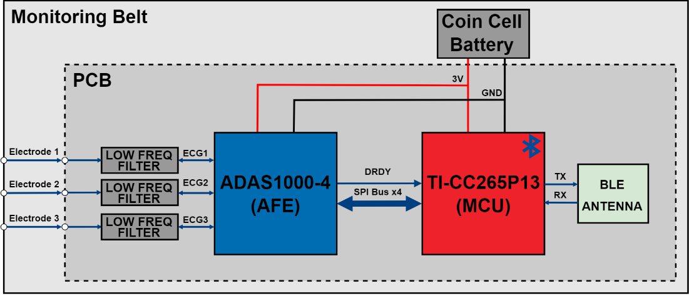

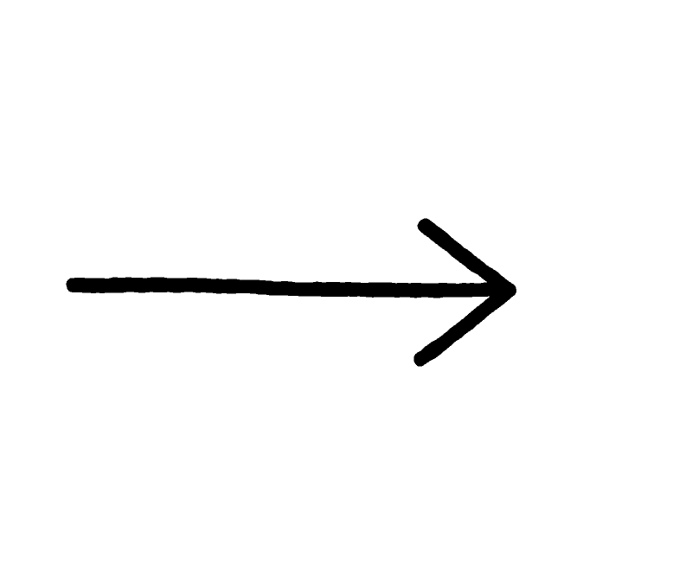

FUNCTIONAL BLOCK DIAGRAM
Notes:
Anthony

Slide 8
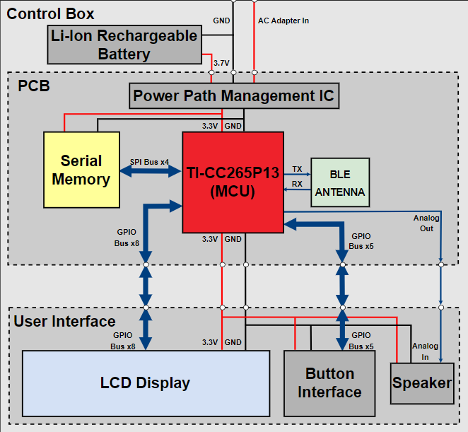

microSD
Notes:
Anthony

Slide 9
PRODUCT REQUIREMENTS
Apnea monitor belt
Bluetooth connectivity
Battery powered
Electrodes for sensing
Adjustable
Portable Control Box
Bluetooth connectivity
On-board display
Custom Alarm
Buttons for user-interfacing
Dual power mode (Battery/AC adapter): 6 hrs lifespan min.
Data Logging + Storage
Monitoring
Electrocardiogram (ECG/EKG) - Respiratory Rate
Notes:
Charan Out of Scope- FDA, App

Slide 10
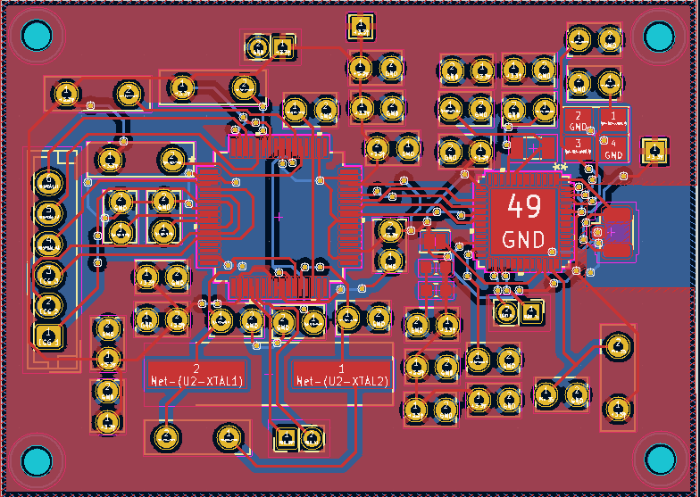
ELECTRICAL SYSTEM UPDATES
Notes:
Anthony

Slide 11
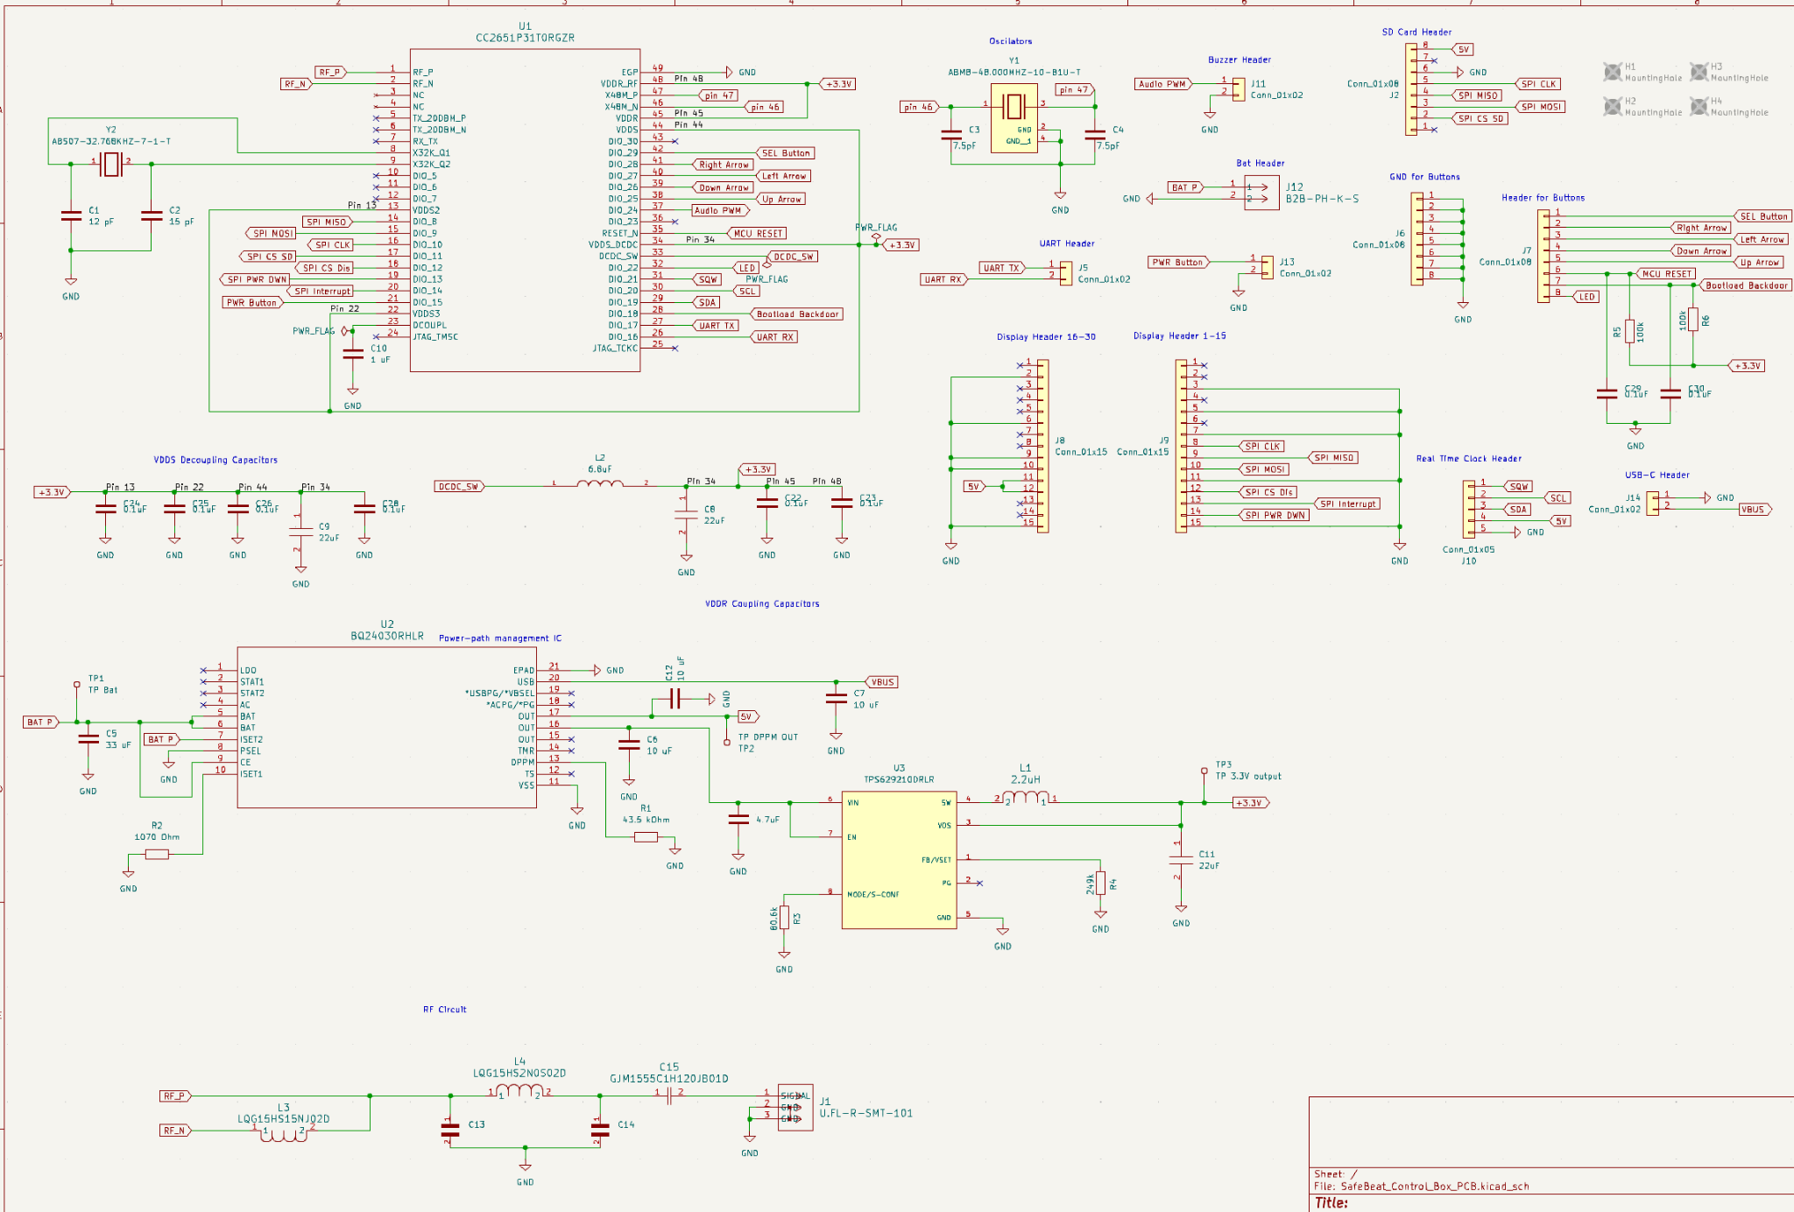
ELECTRICAL SYSTEM UPDATES
Notes:
Anthony

Slide 12
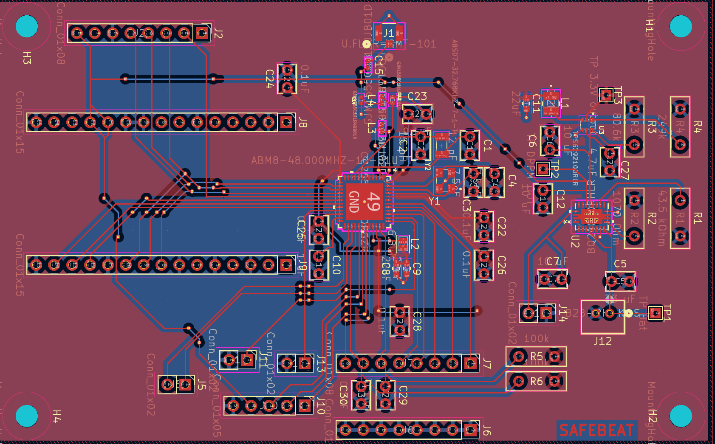
ELECTRICAL SYSTEM UPDATES
Notes:
Anthony

Slide 13
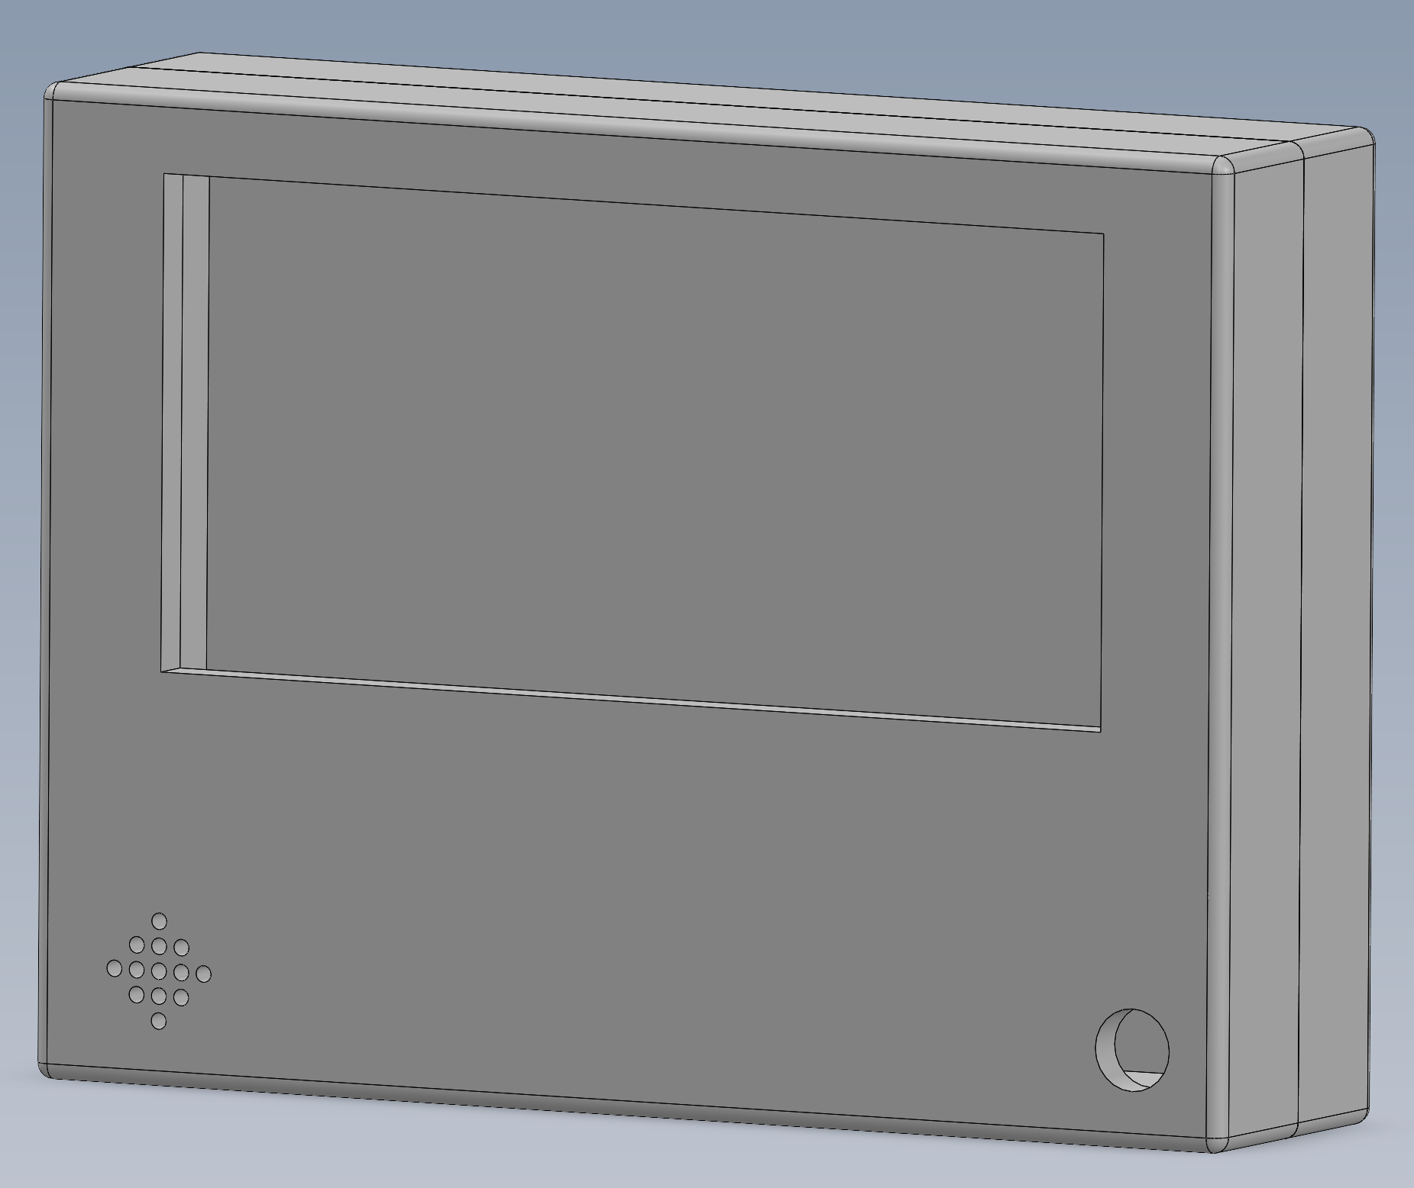
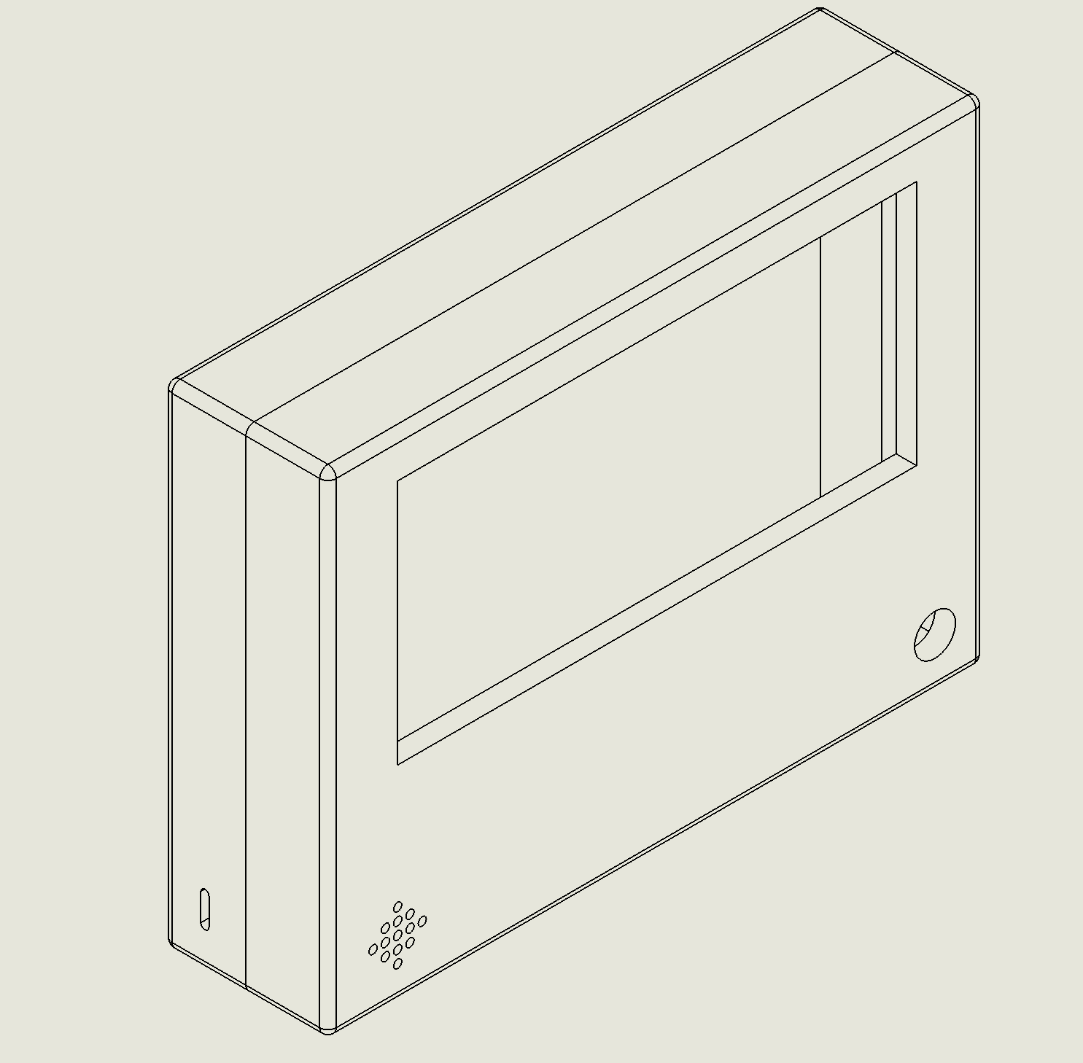
MECHANICAL UPDATES
Control Box
Notes:
Anthony
diagonal 7 inch display
no buttons expected the on/off

Slide 14
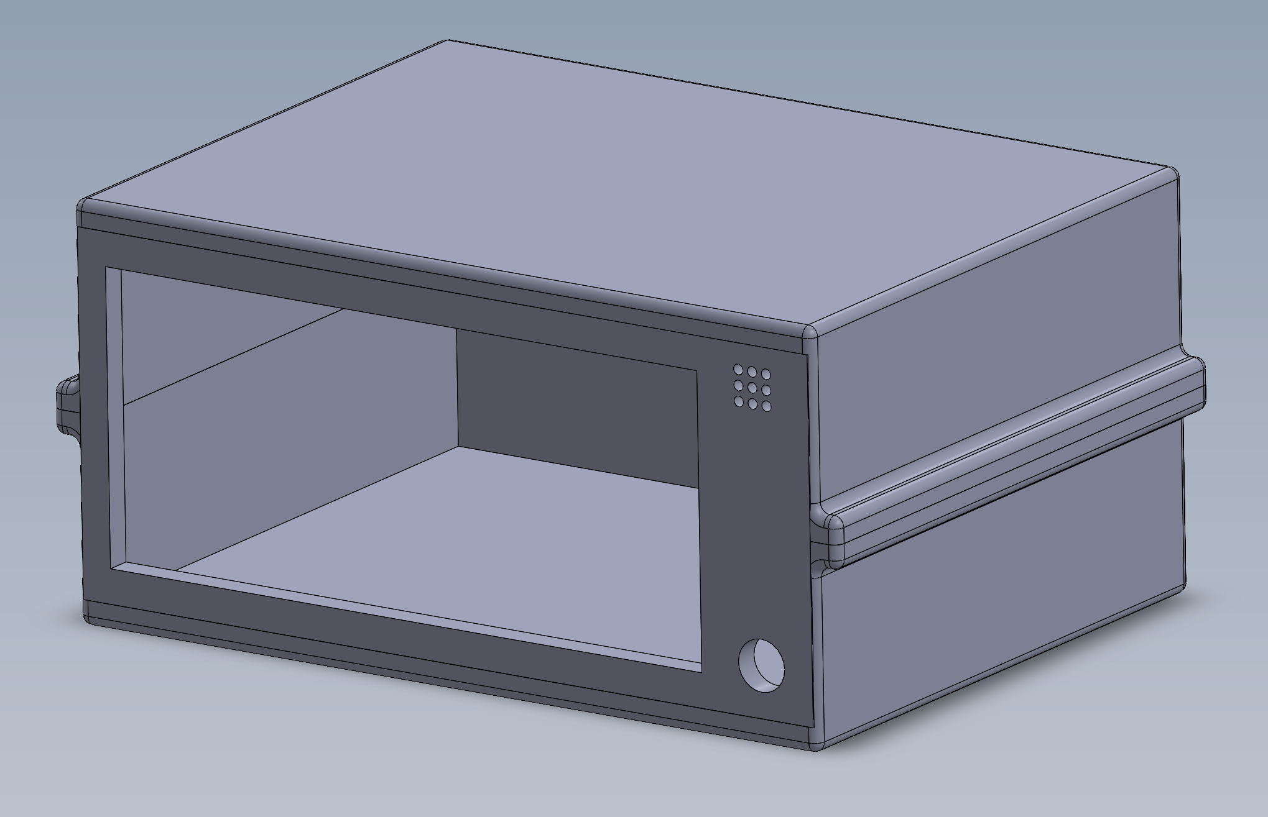
MECHANICAL UPDATES
Control Box
Notes:
Anthony
diagonal 7 inch display
no buttons expected the on/off

Slide 15
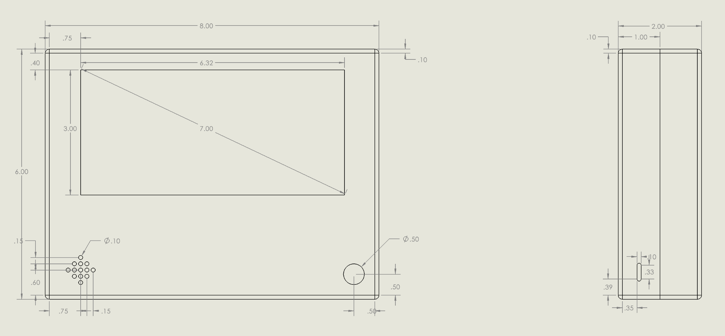
MECHANICAL UPDATES
Control Box
Notes:
Anthony
diagonal 7 inch display
no buttons expected the on/off

Slide 16
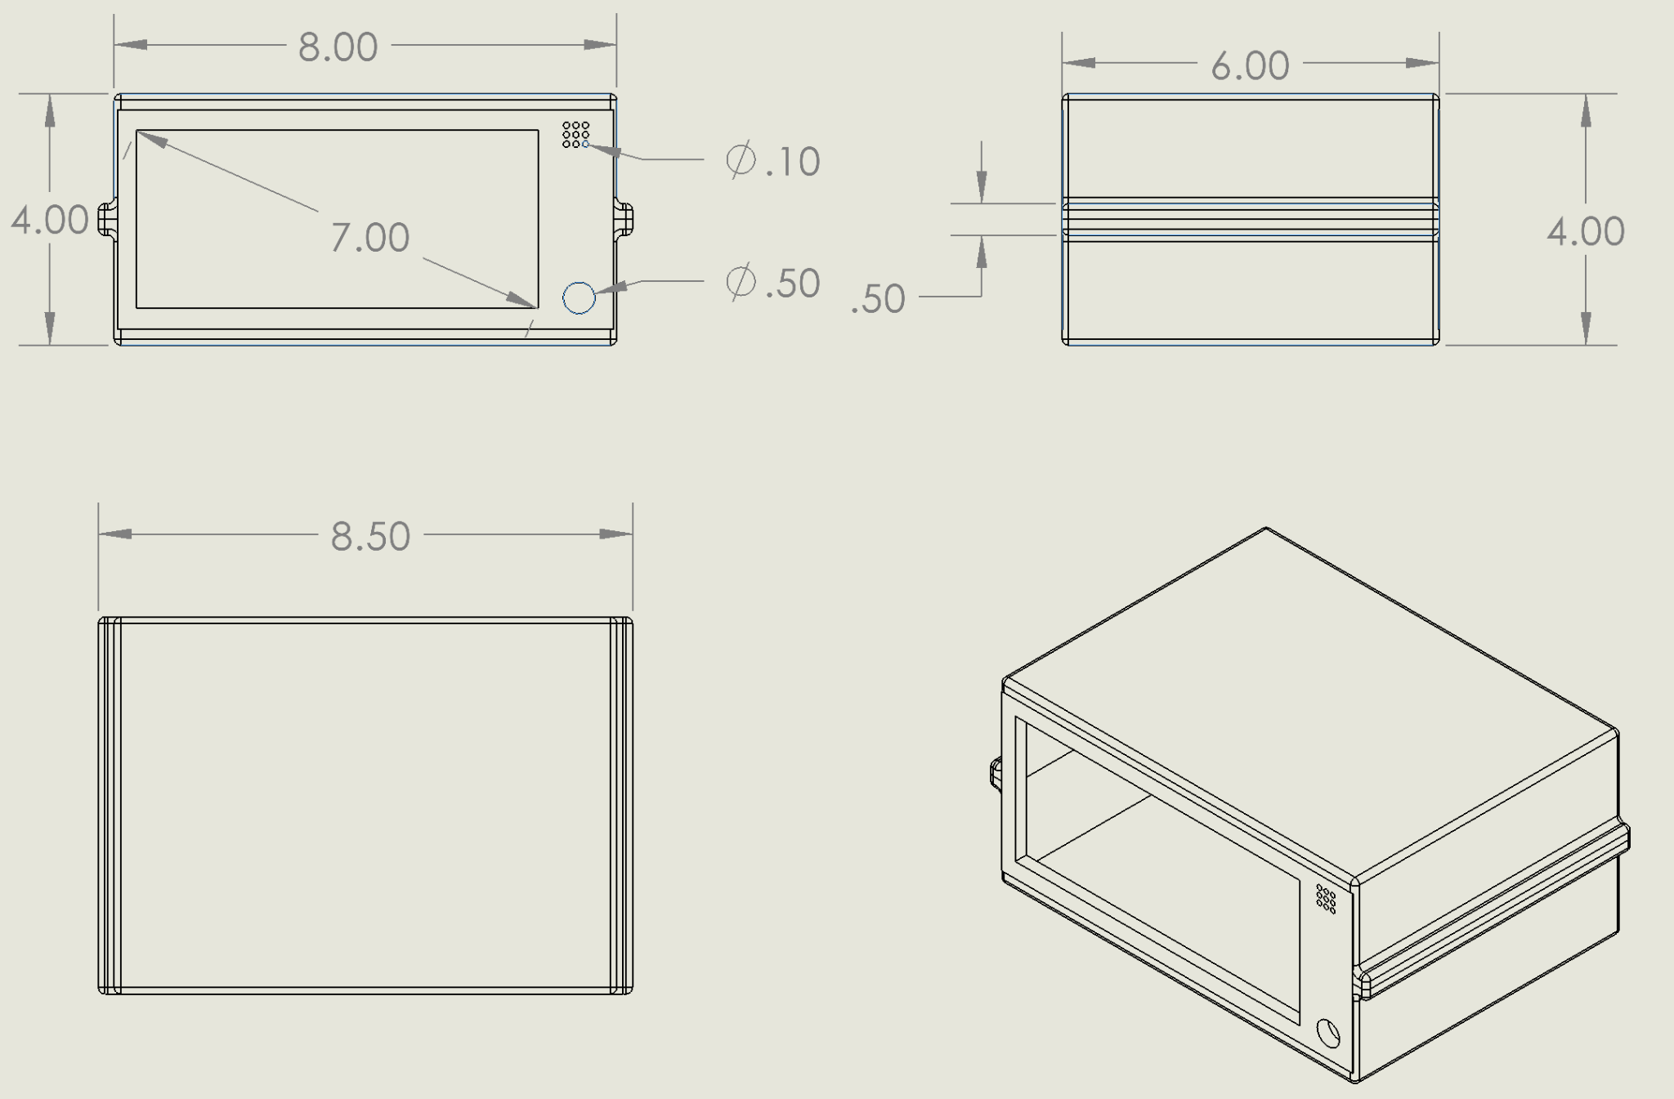
MECHANICAL UPDATES
Control Box
Notes:
Anthony
diagonal 7 inch display
no buttons expected the on/off

Slide 17
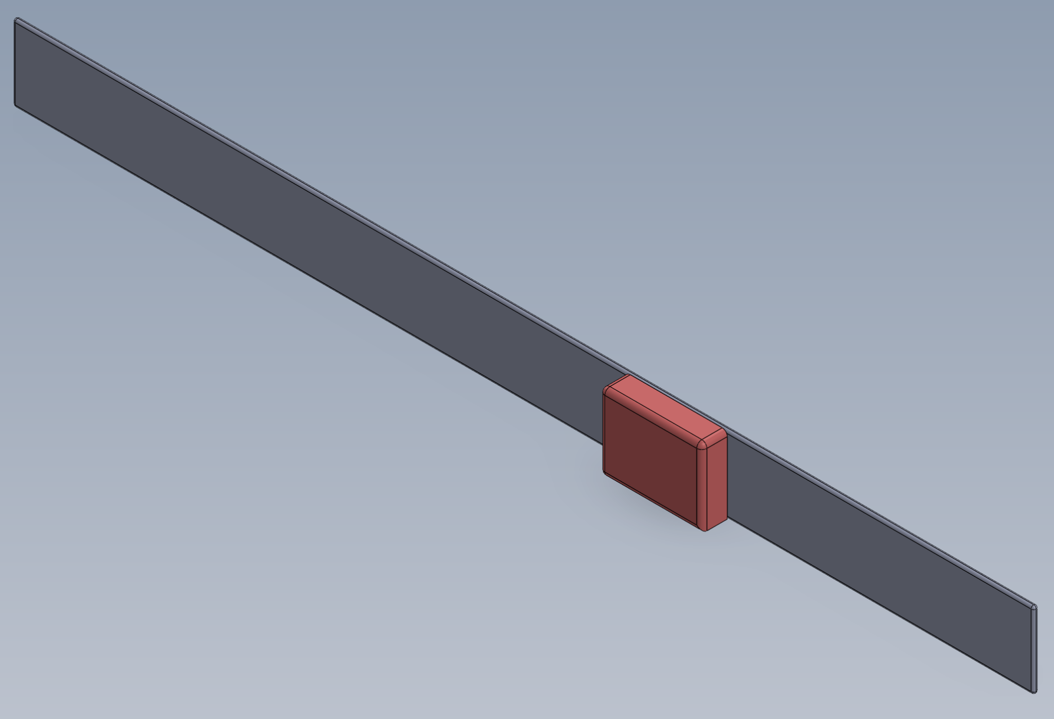
MECHANICAL UPDATES
Monitoring Belt
Notes:
Anthony

Slide 18
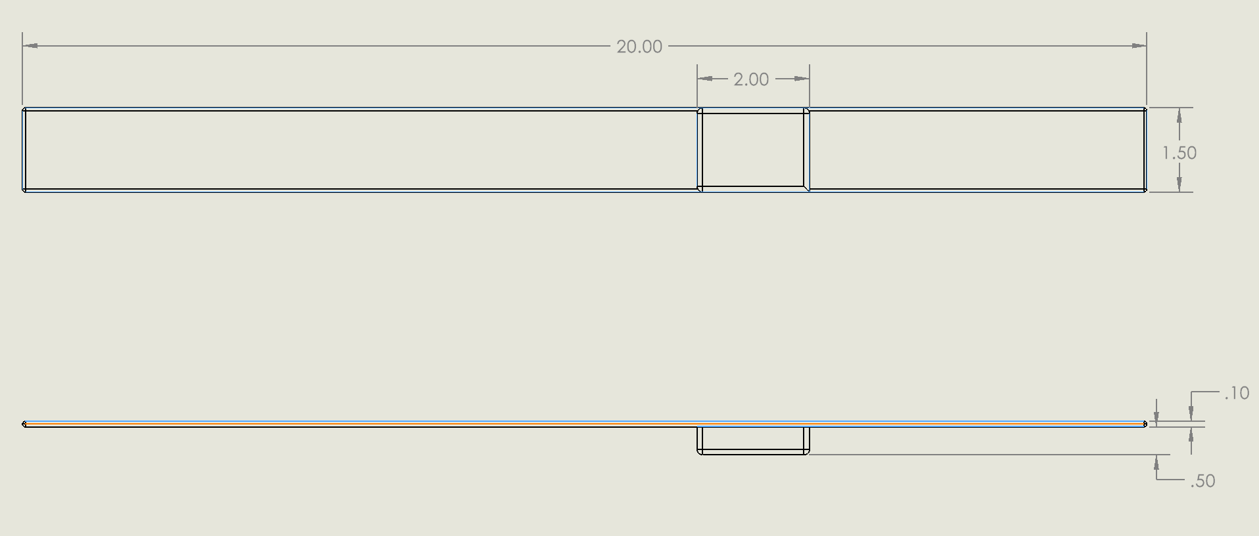
MECHANICAL UPDATES
Monitoring Belt
Notes:
Anthony

Slide 19
SOFTWARE REQUIREMENTS
Apnea Monitor Belt:
MCU will read electric signals of heart rate and respiration rate.
Wireless transmission using Bluetooth.
Temperature and power monitoring for safety and increased battery life.
Control Box:
Wireless transmission using Bluetooth.
User interface display to show vital data and menu updates
Button controls to adjust upper and lower thresholds
Built-in alarm system to notify abnormal biometrics.
Data Logging with timestamps, stored in external storage
Temperature and power monitoring for safety and increased battery life.
Notes:
Charan

Slide 20
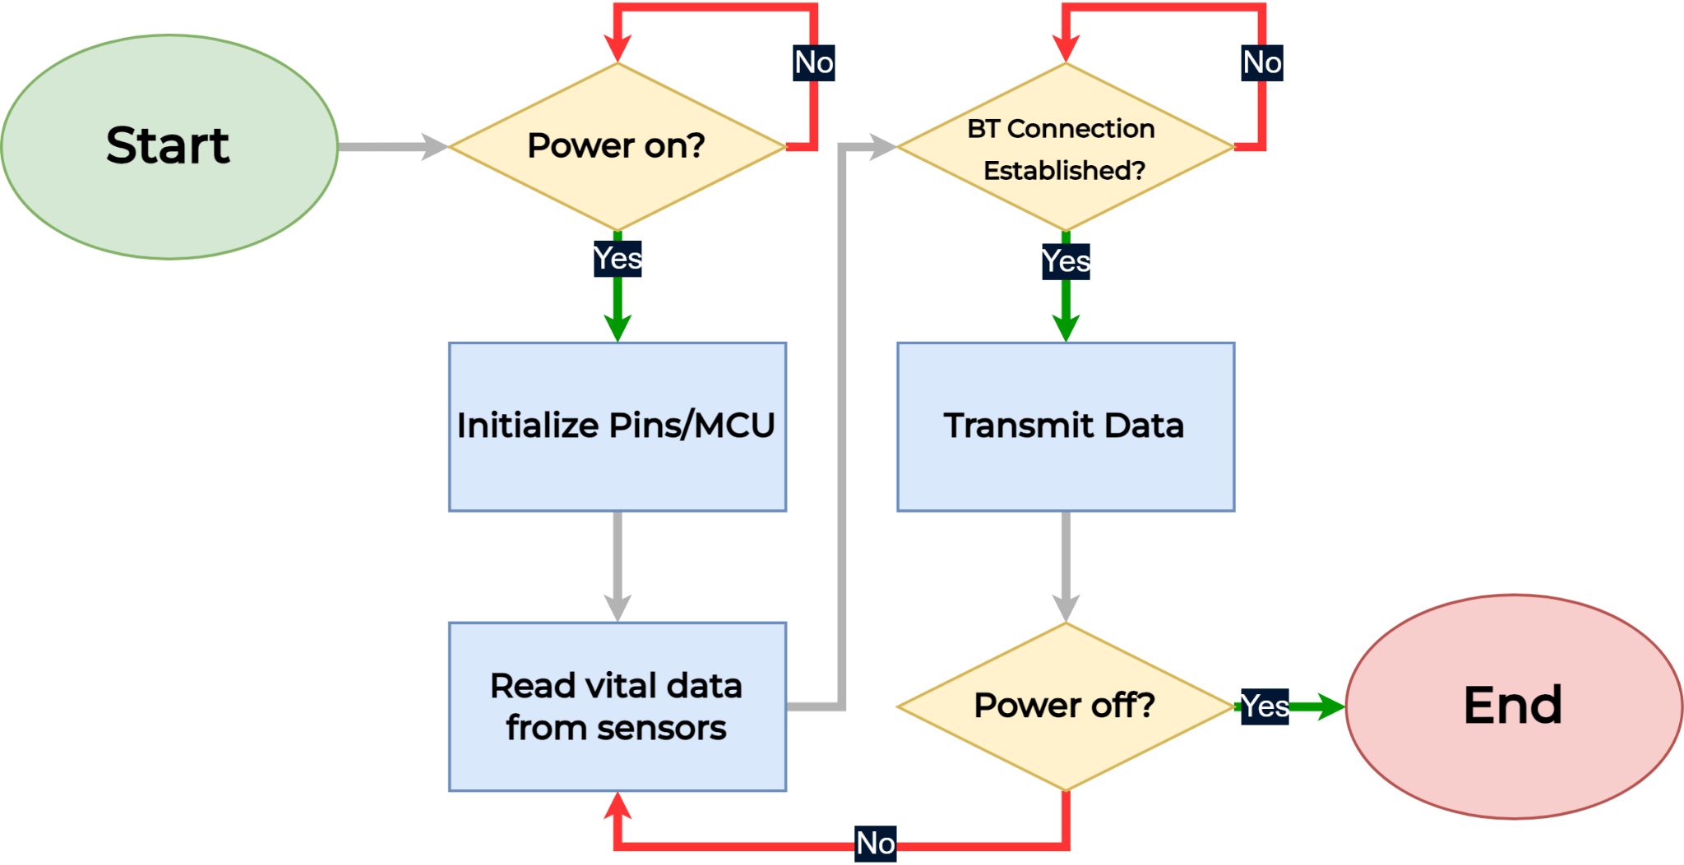
SOFTWARE MAP - BELT
Notes:
Ch

Slide 21
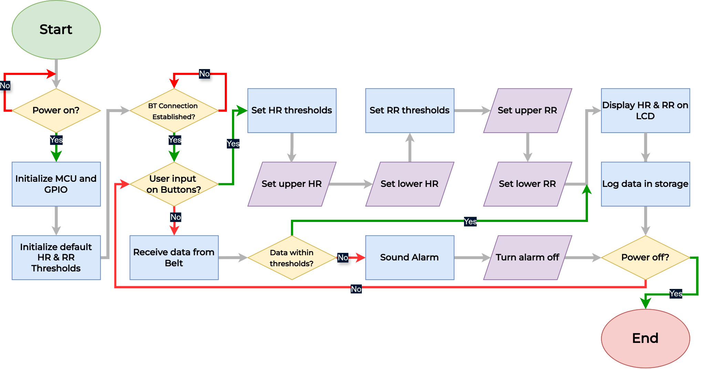
SOFTWARE MAP - CONTROL BOX

Slide 22
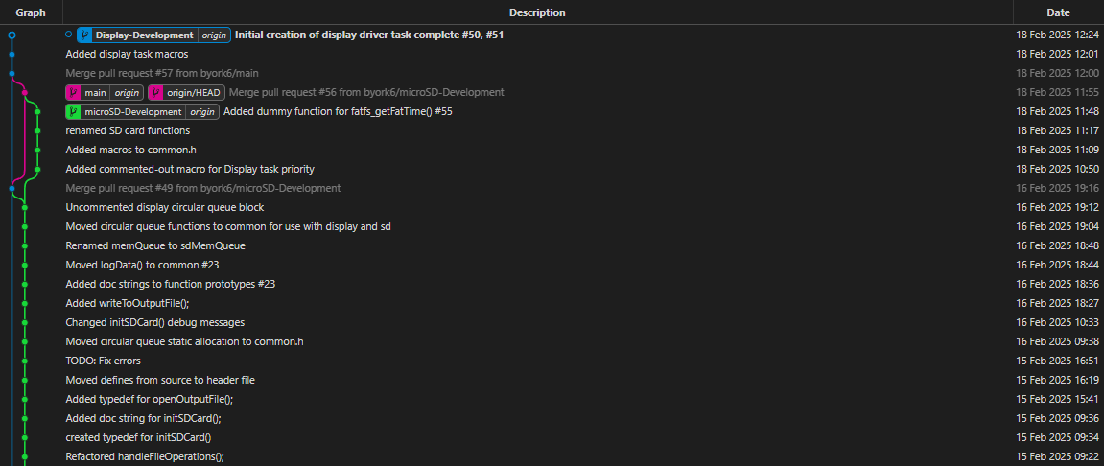
SOFTWARE UPDATES
Notes:
Brian

Slide 23

PERIPHERAL UPDATES
Updates with Display:
Soldered pins onto display board.
Fixed all errors within the setup, wrote code for SPI
6 SPI pins used - 4 standard SPI pins (CLK, CS, MOSI, MISO) & 2 extra SPI pins (Touch interrupt pin & Power Down pin).
Continuing to write code for display
Notes:
Brian

Slide 24
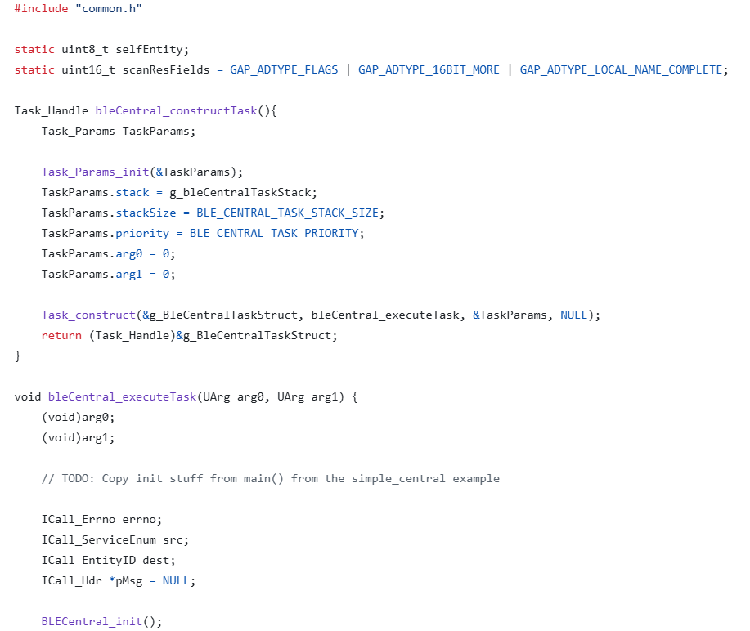
SOFTWARE UPDATES
Updates with Bluetooth:
Fixed some setup errors
Continuing to work on software for BLE
Notes:
Brian

Slide 25
ECG/Respiratory
Impedance Plethysmography
A non-invasive method to measure respiratory rate and heart activity through impedance changes.
Small AC current is passed through the body.
Voltage changes due to impedance variations caused by respiration and cardiac activity are measured.
Impedance varies with thoracic cavity expansion during respiration.
ECG:
Measures electrical activity of heart contractions (biopotential measurement).
Signal range: 0.5 -> 5.0 mV (with DC offset of +300 mV).
Heart Rate (HR) Calculation:
HR=(# pulses in 10 sec) * 6
Requires filtering and amplification:
Removes frequencies above 150 Hz and below 0.05 Hz (Band-pass: 0.05 Hz - 150 Hz).
Respiratory:
Measures impedance to calculate respiratory rate.
Excitation current parameters:
Frequency: 46.5 - 64 kHz
Amplitude: 8-64 µA peak-to-peak (varies by drive mode).
Impedance Calculation:
Resolution: 0.2 ohms with <5kohm/2pF cable impedance.
Body impedance modeled at 1.2 kohms.
Filters remove noise:
Band-pass filter: 0.05 Hz - 1-2 Hz.
Notes:
Brian ECG/Respiratory Monitoring
Impedance Plethysmography
A non-invasive method to measure respiratory rate and heart activity through impedance changes.
Principle:
Small AC current is passed through the body.
Voltage changes due to impedance variations caused by respiration and cardiac activity are measured.
Impedance varies with thoracic cavity expansion during respiration.
ECG
Measures electrical activity of heart contractions (biopotential measurement).
Signal range: 0.5 -> 5.0 mV (with DC offset of +300 mV).
Heart Rate (HR) Calculation:
HR=(#pulses in 10 seconds)×6HR = (\# \text{pulses in 10 seconds}) \times 6HR=(#pulses in 10 seconds)×6
Requires filtering and amplification:
Removes frequencies above 150 Hz and below 0.05 Hz (Band-pass: 0.05 Hz - 150 Hz).
Respiratory Monitoring
Measures impedance to calculate respiratory rate.
Excitation current parameters:
Frequency: 46.5 - 64 kHz (as per ADAS1000 datasheet).
Amplitude: 8-64 µA peak-to-peak (varies by drive mode).
Impedance Calculation:
Resolution: 0.2 ohms with <5kohm/2pF cable impedance.
Body impedance modeled at 1.2 kohms.
Filters remove noise:
Band-pass filter: 0.05 Hz - 1-2 Hz.
Why Impedance Plethysmography?
Accurate & Real-Time: Provides simultaneous ECG and respiratory monitoring.
Low Power: Essential for portable medical devices.
Integration: Enables reliable data transfer via Bluetooth to control box and storage.

Slide 26
ECG/Respiratory FAQ
Respiratory:
Impedance Plethysmography
Force ac current, measure voltage, calculate impedance.
Excitation current frequency between 46.5 and 64 kHz according to page 5 of ADAS1000 datasheet.
Excitation current amplitude between 8-64 uA peak to peak depending on drive mode.
Impedance calculated by AFE chip, measurement resolution of 0.2 ohms with cable impedance <5 kohm/2pf and 0.02 ohms with no cable impedance (Body impedance modeled at 1.2kohm)
Typical filter for respiratory removes frequencies above 1-2 Hz and frequencies below 0.05 Hz
Band pass fc1=0.05 Hz, fc2=1-2Hz
ECG:
Measures electrical activity of the heart contractions (In voltage, also called biopotential measurement)
0.5 -> 5.0 mV range
+300 mV with DC component
typical heart rate: 80 -> 160 bpm
typical HR calculation:
HR = (# pulses in 10 sec) * 6
Measurement must be filtered and amplified.
Typical filter for ECG removes frequencies above 150 Hz and below 0.05 Hz.
Band pass fc1=0.05, fc2=150
Notes:
Brian ECG/Respiratory Monitoring
Impedance Plethysmography
A non-invasive method to measure respiratory rate and heart activity through impedance changes.
Principle:
Small AC current is passed through the body.
Voltage changes due to impedance variations caused by respiration and cardiac activity are measured.
Impedance varies with thoracic cavity expansion during respiration.
ECG
Measures electrical activity of heart contractions (biopotential measurement).
Signal range: 0.5 -> 5.0 mV (with DC offset of +300 mV).
Heart Rate (HR) Calculation:
HR=(#pulses in 10 seconds)×6HR = (\# \text{pulses in 10 seconds}) \times 6HR=(#pulses in 10 seconds)×6
Requires filtering and amplification:
Removes frequencies above 150 Hz and below 0.05 Hz (Band-pass: 0.05 Hz - 150 Hz).
Respiratory Monitoring
Measures impedance to calculate respiratory rate.
Excitation current parameters:
Frequency: 46.5 - 64 kHz (as per ADAS1000 datasheet).
Amplitude: 8-64 µA peak-to-peak (varies by drive mode).
Impedance Calculation:
Resolution: 0.2 ohms with <5kohm/2pF cable impedance.
Body impedance modeled at 1.2 kohms.
Filters remove noise:
Band-pass filter: 0.05 Hz - 1-2 Hz.
Why Impedance Plethysmography?
Accurate & Real-Time: Provides simultaneous ECG and respiratory monitoring.
Low Power: Essential for portable medical devices.
Integration: Enables reliable data transfer via Bluetooth to control box and storage.

Slide 27
PROJECT STATUS
The numbers.
Notes:
Charan

Slide 28
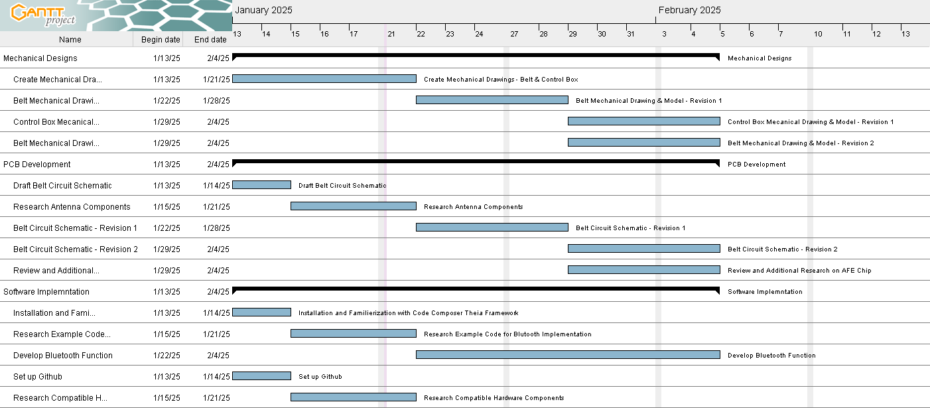
GANTT
Notes:
Anthony

Slide 29
 | PREDICTED | ACTUAL | DELTA | NEXT WEEK | CUMULATIVE
AARADANAA | 6 | 6 | 0 | 6 | 12
VENKATA | 6 | 5.5 | -0.5 | 6 | 11
BRIAN | 6 | 7.5 | +1.5 | 6 | 15
JONATHAN | 6 | 6.5 | +0.5 | 6 | 13
ANTHONY | 6 | 5 | -1 | 6 | 10
TOTAL | 30 | 30.5 | +0.5 | 30 | 61
Notes:
Charan

Slide 30
LABOR STATUS SUMMARY
373
402
Original Estimated Hours
Current Total Hours
371.5
31
Remaining Labor
12
Weeks Remaining
Minimum Hours per week
Notes:
Charan

Slide 31
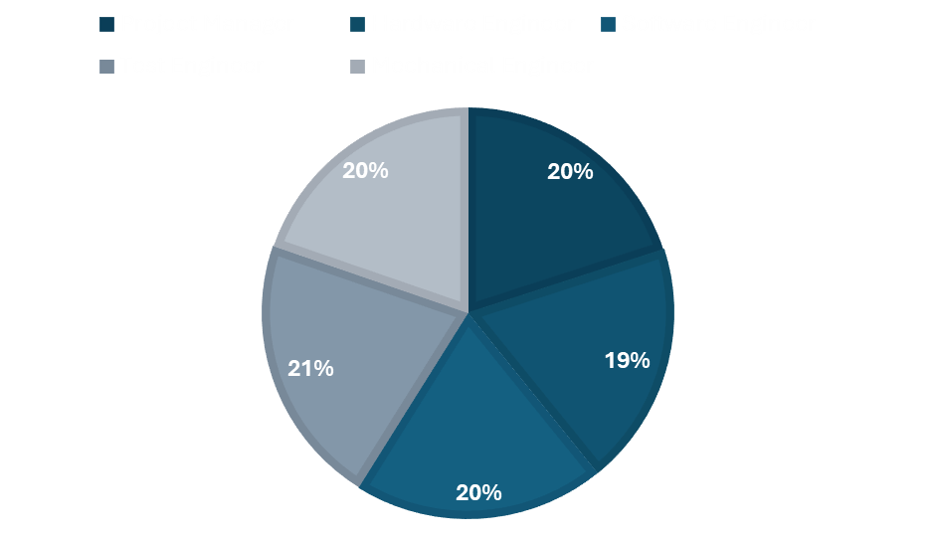
RESOURCE ALLOCATION
20%
19.17%
19.72%
Project Manager
Hardware Engineer
Software Engineer
21.39%
19.72%
Test Engineer
Mechanical Engineer
Notes:
Charan

Slide 32
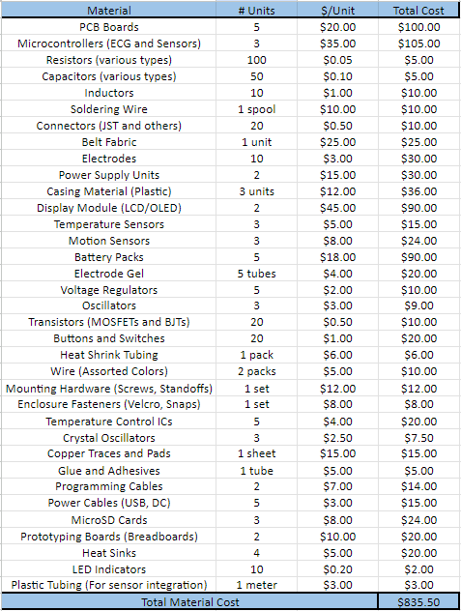
BILL OF MATERIALS
$835.50
Total Material Cost
Notes:
Charan

Slide 33
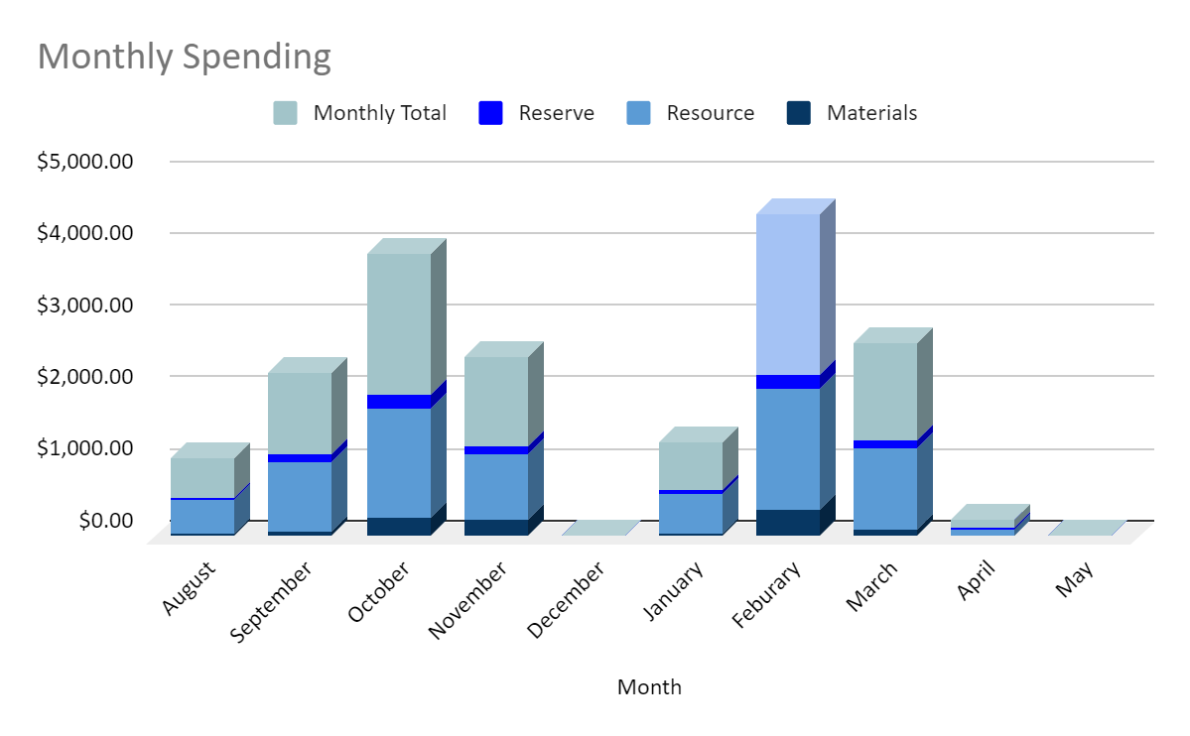
BUDGET OVERVIEW
$10,480
Total Project Spending
$1,085
Total Material Cost
$839.50
Reserve Funds

Slide 34
MOVING FORWARD…
Finish Design
Order Materials
Prototyping
Construction
Test
Notes:
Charan

Slide 35
Thank you!
Any questions?
Contact us at:
safebeatmonitor@gmail.com

